Slide 1


How to build a constructicon in five years: The Russian recipe
Laura A. Janda (UiT)
SCLC-2020/2021: Slavic Cognitive Linguistics Conference, Tromsø, Norway, June 3, 2021

Slide 2
Team behind this project
Laura A. Janda (UiT The Arctic University of Norway): Background research, Concept, Design, Data mining, Editing of content, Dissemination of findings and results
Tore Nesset (UiT The Arctic University of Norway): Background research, Concept, Design, Editing of content, Dissemination of findings and results
Ekaterina Rakhilina (National Research University Higher School of Economics in Moscow, Vinogradov Institute of Russian Language at Russian Academy of Sciences): Background research, Concept, Design, Content, Data mining, Semantic annotation, Editing, Dissemination of findings and results
Olga Lyashevskaya (National Research University Higher School of Economics in Moscow, Vinogradov Institute of Russian Language at Russian Academy of Sciences): Concept, Design, Data mining, UD analysis, Syntactic annotation, Dissemination of findings and results
Francis M. Tyers (Indiana University; earlier affiliated with UiT The Arctic University of Norway and National Research University Higher School of Economics): Concept, Design, UD for Russian
Radovan Bast (UiT The Arctic University of Norway, Department of information technology): New user interface, design and programming
Marianne Lund: Translation of definitions to Norwegian
Valentina Zhukova (National Research University Higher School of Economics in Moscow): Content, Design, Data mining, Semantic and syntactic annotation, Dissemination of findings and results
Daria Mordashova (Lomonosov Moscow State University, Institute of Linguistics of the Russian Academy of Sciences): Content, Design, Data mining, Semantic and syntactic annotation, Dissemination of findings and results
Anna Endresen (UiT The Arctic University of Norway): Content, Design, Data mining, Editing, Semantic and syntactic annotation, Usage labels, Dissemination of findings and results, Coordination of teamwork

Slide 3
Overview
What is a construction?
What is a constructicon?
Why build a constructicon?
How to build a constructicon:
Collection of constructions
Classification of constructions
Presentation of constructions

Slide 4
What is a construction?
A construction is:
any conventionalized form-meaning pairing in a language, at any level of complexity, from morpheme through lexeme through phrase to discourse structure (Goldberg 2006, 5)
the basic (though not elementary) unit that structures language
A construction may be compositional or non-compositional
All meaningful units of a language are constructions
An entire language can be described in terms of constructions

Slide 5

“It’s constructions all the way down” (Goldberg 2006: 18)

Slide 6

Examples of Russian constructions
morphemes
-t’ = INF
lexemes
tancevat’ ‘dance’
multi-word idioms where all slots are fixed
tancevat’ ot Adama ‘start from the very beginning’
multi-word expressions with open slots
VP pod NP-Acc
Ona tancevala pod muzyku ‘She danced to the music’
larger discourse units
Our project focuses mainly on this type of construction

Slide 7
What is a constructicon?
A constructicon is:
a structured inventory of constructions in a given language
Constructicons exist for:
English
German
Swedish
Japanese
Brazilian Portuguese
The Russian Constructicon is by far the largest,
with over 2200 constuctions

Slide 8
Why build a constructicon?
For linguists
to achieve improved description of languages
to extend theory of construction grammar
to facilitate cross-linguistic typological comparison
For L2 learners
to achieve greater language proficiency
to motivate use of specific wordforms
to fill in gaps in current language resources and pedagogy

Slide 9
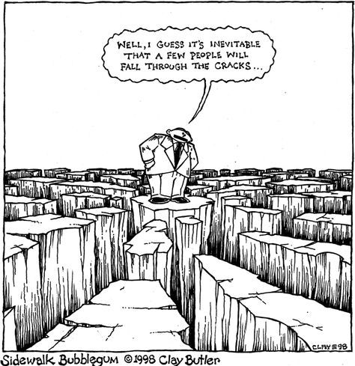
Filling in the gaps
It seems that a few things
just fall through the cracks
Dictionaries, grammars, and textbooks focus primarily on lexemes, lexicalized idioms, inflectional paradigms,and grammatical patterns
Multi-word expressions with open slots are less reliably represented in standard resources
TEXTBOOK
PHRASE
BOOK
GLOSSARY
DICTIONARY
REFERENCE
GRAMMAR

Slide 10
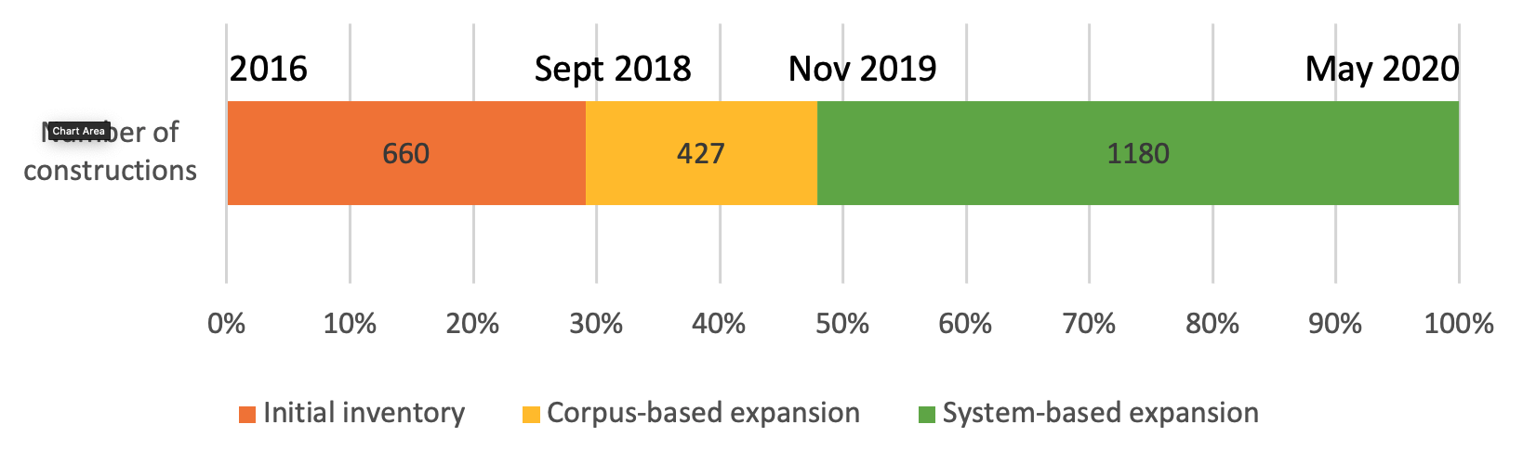
How to build a constructicon: Collection of constructions
Manual collection from textbooks, scholarly literature, crowdsourcing
Extraction from dialogs, spoken discourse, and RNC collocations
Classification of syntactic & semantic types
Searches for synonyms, antonyms and anchor words based on semantic classification

Slide 11
How to build a constructicon: Classification of constructions
Families
a family is a relatively homogeneous group of approx. 2-9 constructions that share some semantic, syntactic, and/or structural properties
the constructions in a family share various subsets of these properties
semantic and syntactic tags facilitate identification of families
annotation by a panel of three native speakers
Clusters
a cluster is a group of families that are linked to through semantic and/or syntactic similarities in a prototypical vs. peripheral distribution, usually corresponding to semantic subtypes in annotation
Networks
a network is a group of clusters that share a general semantic tag

Slide 12
Constructionalization as grammaticalization
Conventionalization of form-meaning pairings can be understood as an early stage in the process of grammaticalization
The semantic tags are quasigramatical meanings that are distributed across constructions and their (partially bleached) anchor words
Classification rests on lexical functions (cf. Mel’čuk, Apresjan) which are comparable across languages

Slide 13
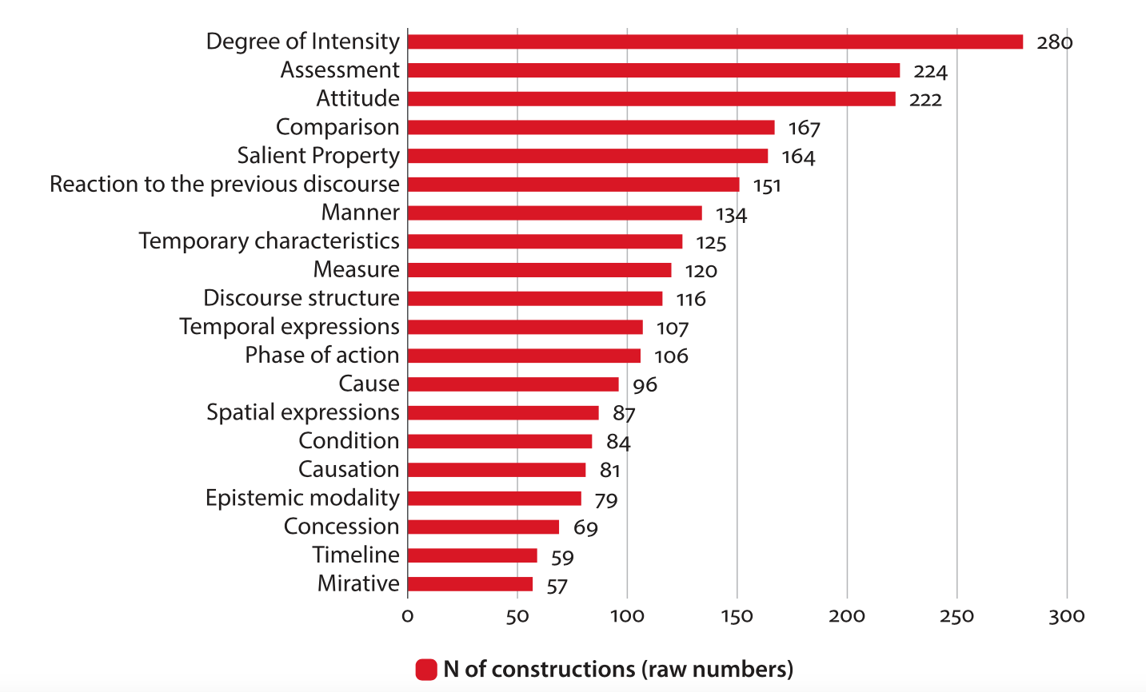
Distribution of constructions across the most frequent general semantic tags

Slide 14
We will hear more about semantic classification in general and about Intensity, Assessment, and Attitude constructions in other presentations today
Now we will take a look at a smaller network: Prohibitive constructions

Slide 15
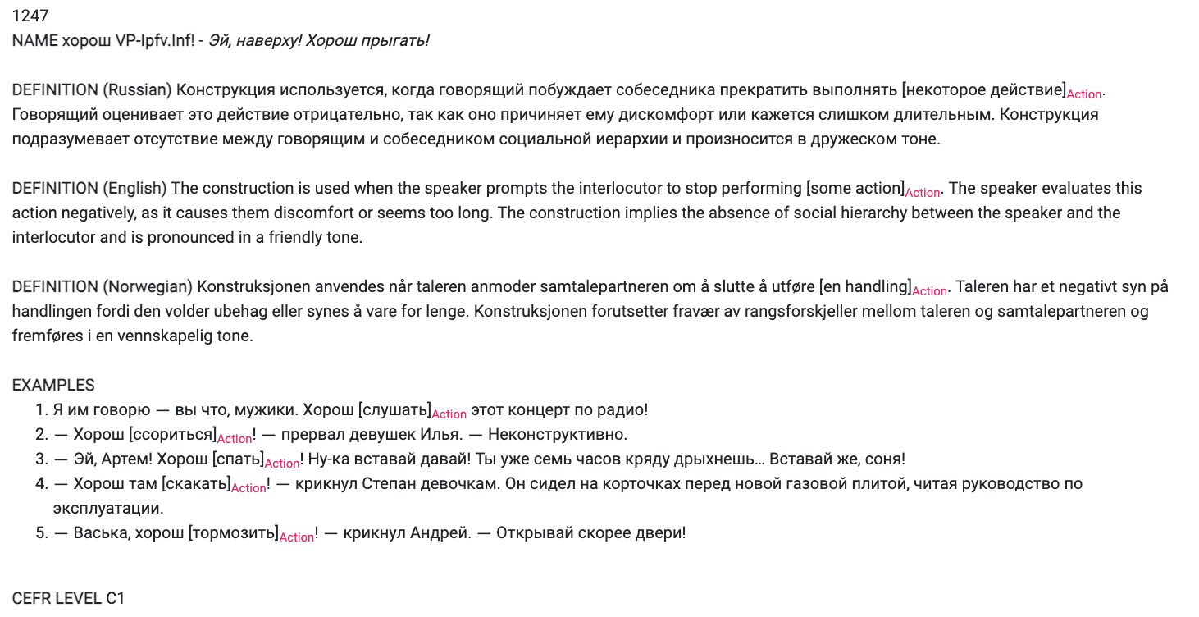
An example of a Prohibitive construction

Slide 16
anchor
slot

Slide 17
overlap with Intensity
1:2 (7 constructions)
General rules
Ne VP-Inf!
‘No X-ing!’
1:4 (7 constructions)
Prohibition of smallest portion
Nikakix NP-Gen!
‘No X-es!’
1:5 (3 constructions)
Anticipation of resistance
Ne VP-Fut.2!
‘You’re not going to do X!’
Cluster 1
predicative
generalization
intensification
opposition to resistance
generalization
option
opposition to repetition
overlap with Request
1:3 (9 constructions)
Milder tone
(NP-Dat) ne stoit VP-Inf
‘There’s no point in X-ing’
1:1 (4 constructions)
Prevention of intended activity
Ne smej VP-Imp.Inf
‘Don’t you dare X’
1:6 (2 constructions)
Prohibition against repeating
Čtob(y) Pron bol’še ne VP-Past!
‘No more X-ing!’
overlap with Warning
attenuation
predicative
continuative
imperative
1247
continuative
continuative
2:2 (7 constructions)
Quantitative, milder tone
Xvatit (Pron.2-Dat) VP-Imp.Inf!
‘Enough X-ing!’
2:1 (4 constructions)
Stop unwanted activity
Brosit’-Imper VP-Imp.Inf
‘Stop X-ing!’
aggression
2:5 (3 constructions)
Prohibition and Threat
Ja Pron-Dat VP-Fut!
‘You do X and you will regret it!’
overlap with Threat
attenuation
imperative
option
Cluster 2
further attenuation
temporary
Network of Prohibitive constructions
imperative
2:3 (2 constructions)
Delimitative
po-VP-Imp.Past i xvatit
‘You’ve done enough X-ing’
imperative
option, po- prefix option
2:4 (3 constructions)
Stop temporarily
Podoždat’-Imper VP-Imp.Inf
‘Stop X-ing for a while’
po- prefix

Slide 18
How to build a constructicon: Presentation of constructions
Create a user interface
User-friendly for linguists, teachers, learners
Searchable according to semantics, anchor words, syntax
Open-source, publicly archived data
More about this at the launch later today

Slide 19
Conclusions
Multi-word expressions with open slots are inadequately represented in standard resources (dictionaries, grammars)
There are thousands of such constructions that form a complex system
Once a critical mass of constructions is gathered, systematic patterns emerge that facilitate more efficient collection and classification
Access to a database of grammatical constructions can address the needs of both linguists and learners
The classification is potentially comparable across languages, facilitating future efforts in linguistic typology

